Slide 1
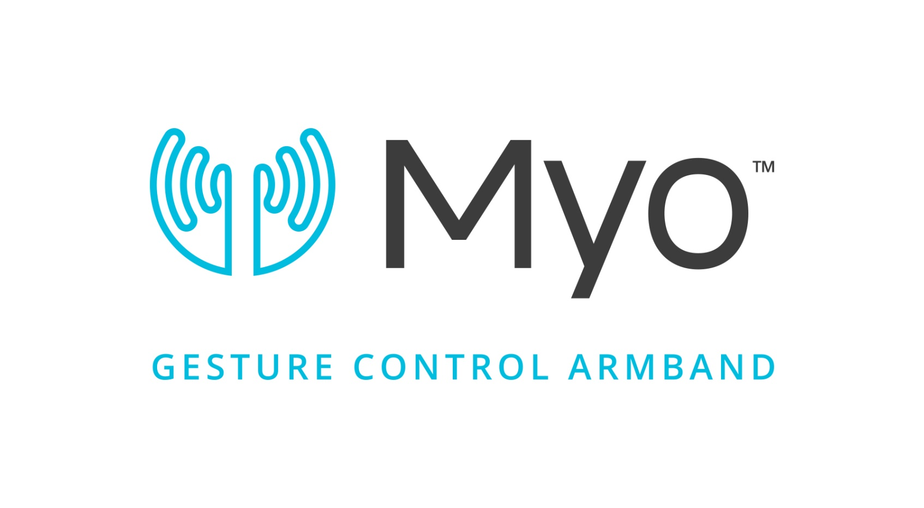
Myo Armband Platform

Slide 2
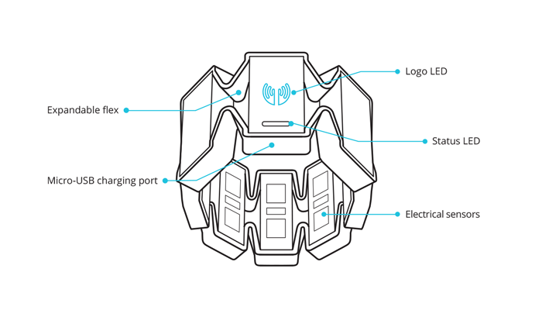
What is a Myo Armband ?

Slide 3
Project Goals/Overview
Record Myo EMG Data
Storing and Sorting EMG Data in MySQL
Visualizing Stored EMG data
Record Video With Synchronized Data
Analysing Muscle Movements
Proof of Concept

Slide 4
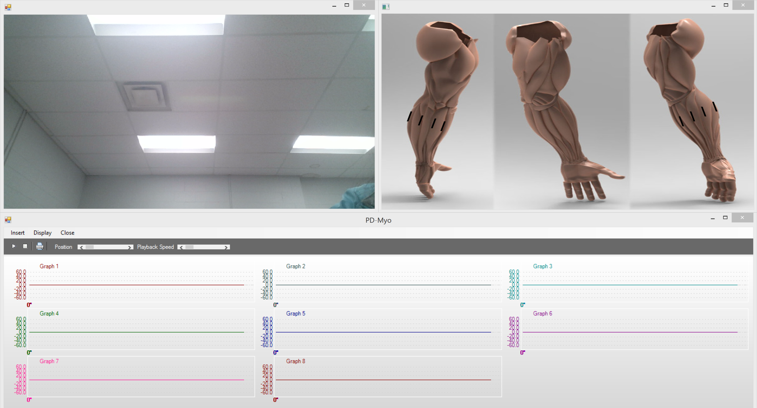
Myo Armband Platform

Slide 5
Recording Myo EMG Data
EMG is a short form for Electromyography
EMG data is a way of recording muscle movements with electricity
8 sensors record the EMG data on a Myo Armband
Each EMG value ranges approximately from a 0 – 150

Slide 6
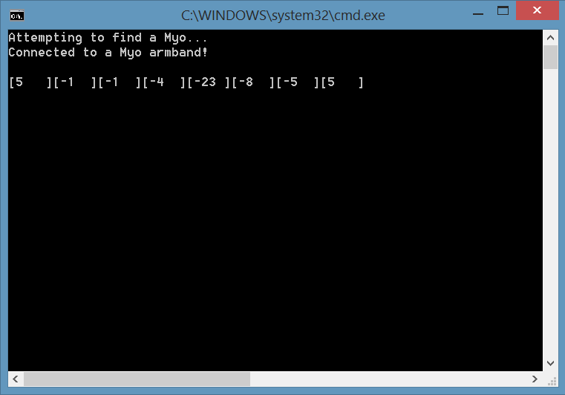
Recording Myo EMG Data

Slide 7
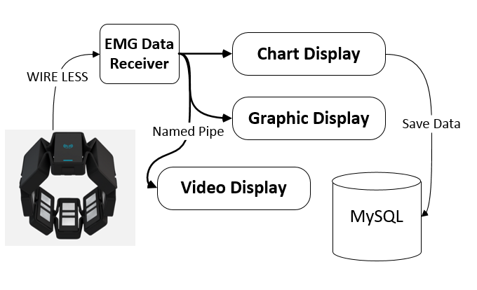
System Diagram

Slide 8
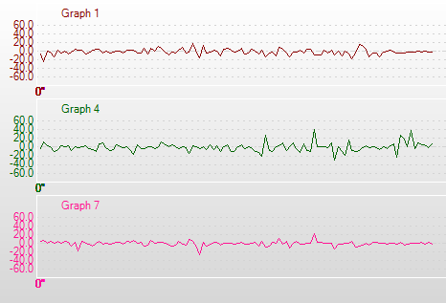
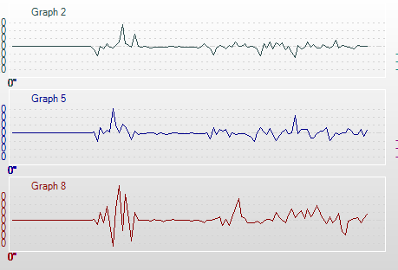
Storing EMG Data in MySQL Database with Visualization

Slide 9
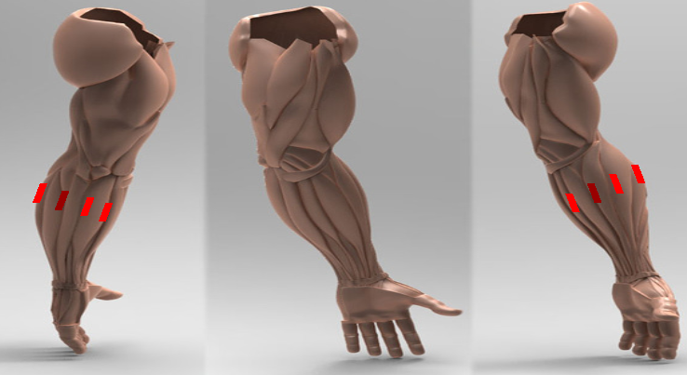
Storing and Sorting EMG Data With Visualization

Slide 10
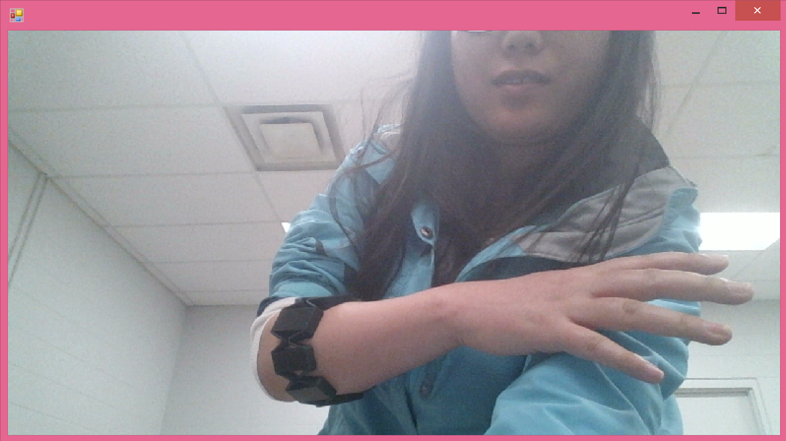
Video Recording

Slide 11
All Data is Stored in Realtime

